Slide 1
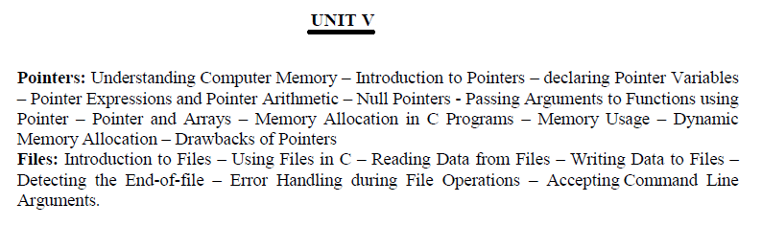

Slide 2
Dynamic Memory Allocation
Dynamic Memory Allocation can be defined as a procedure in which the size of a data structure is changed during the runtime.
C provides some functions to achieve these tasks. There are 4 library functions provided by C defined under <stdlib.h> header file to facilitate dynamic memory allocation in C programming.
They are:
malloc()
calloc()
free()
realloc()

Slide 3
malloc() function
“malloc” or “memory allocation” method in C is used to dynamically allocate a single large block of memory with the specified size.
It returns a pointer of type void which can be cast into a pointer of any form.
It initializes each block with default garbage value.

Slide 4
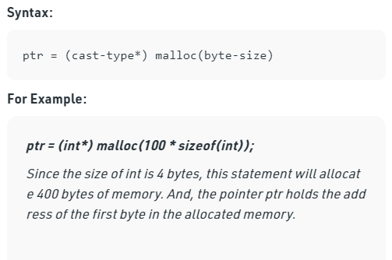

Slide 5
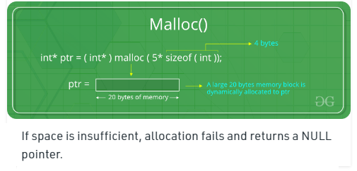

Slide 6
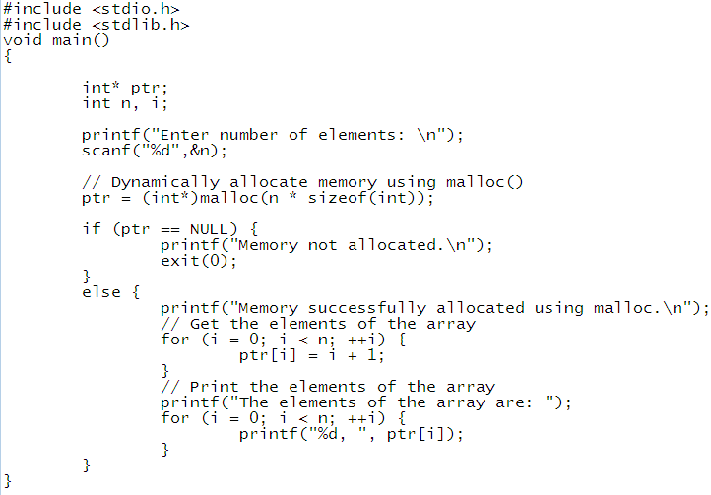

Slide 7
calloc() function
“calloc” or “contiguous allocation” method in C is used to dynamically allocate the specified number of blocks of memory of the specified type. It initializes each block with a default value ‘0’.

Slide 8
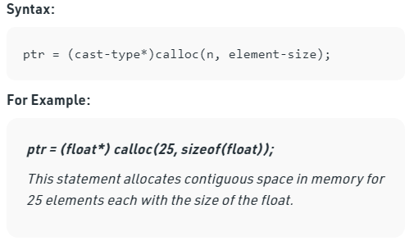

Slide 9
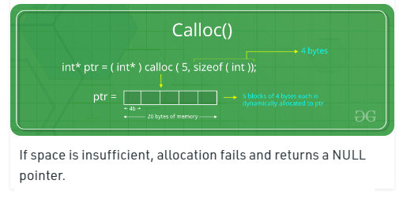

Slide 10


